Slide 1

AtliQ Hardware’s Finance & Supply Chain Analytics
SQL Project
Presented by M B Divya

Slide 2
Project Outline
1.About Company
2.Problem Statement
3.Project Objectives
4.Tools & Database
5.Reports
6.Key Insights

Slide 3
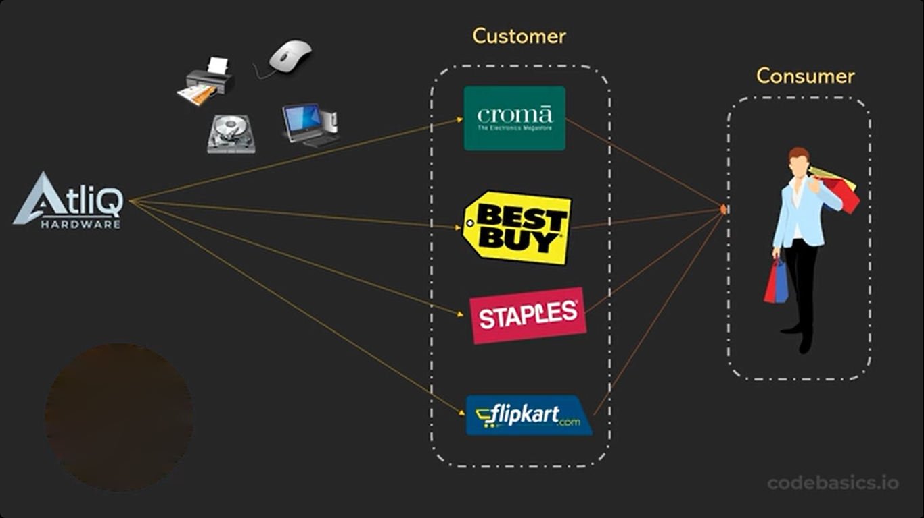
1.About Company
AtliQ is a leading electronics company that manufactures and sells hardware like PCs, mouse, printers and so on across different countries.
Business Model of AtliQ

Slide 4
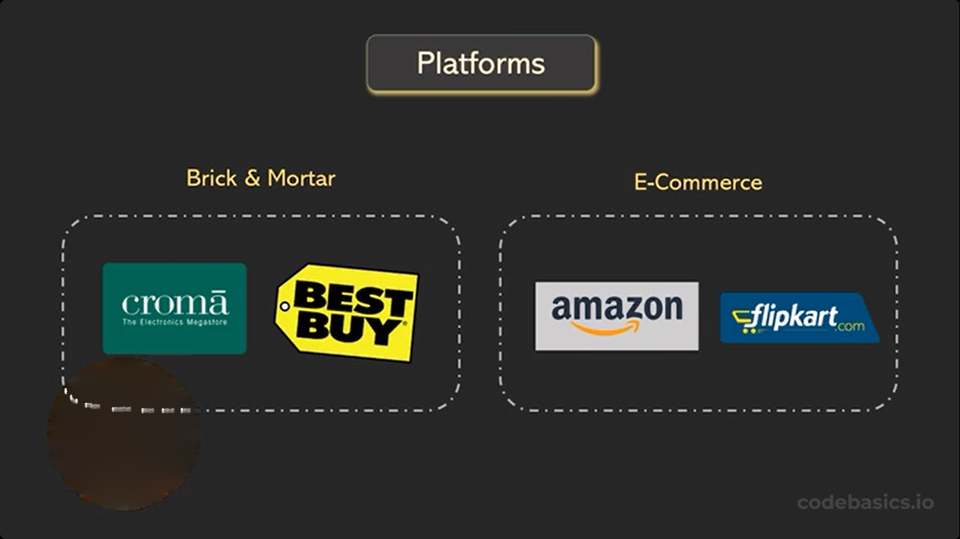
1.About Company

Slide 5
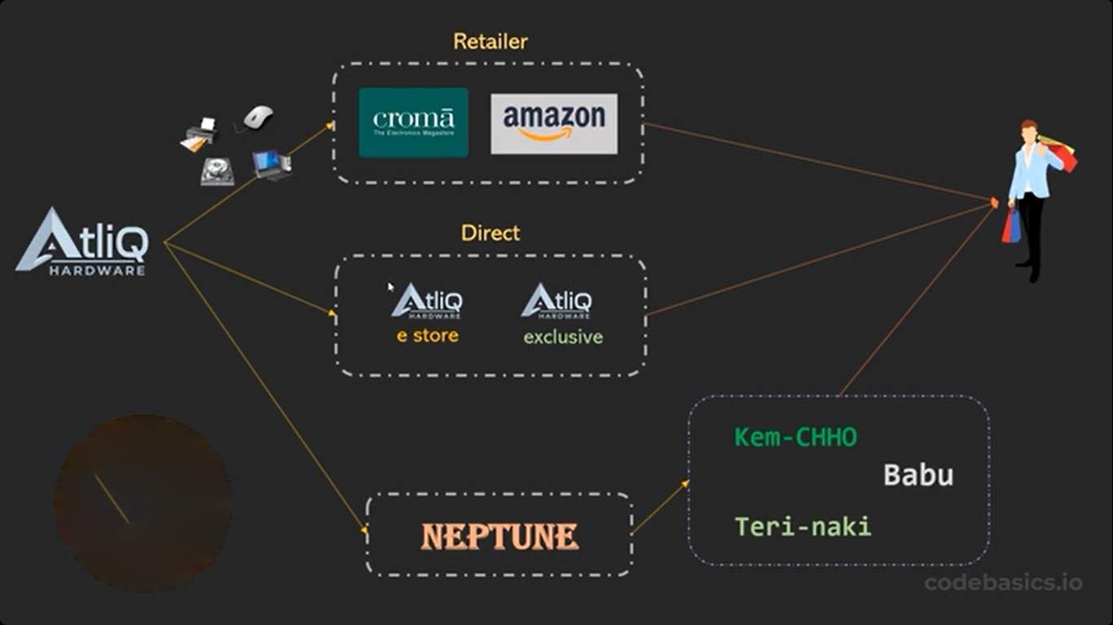
1.About Company
Customer Channel

Slide 6
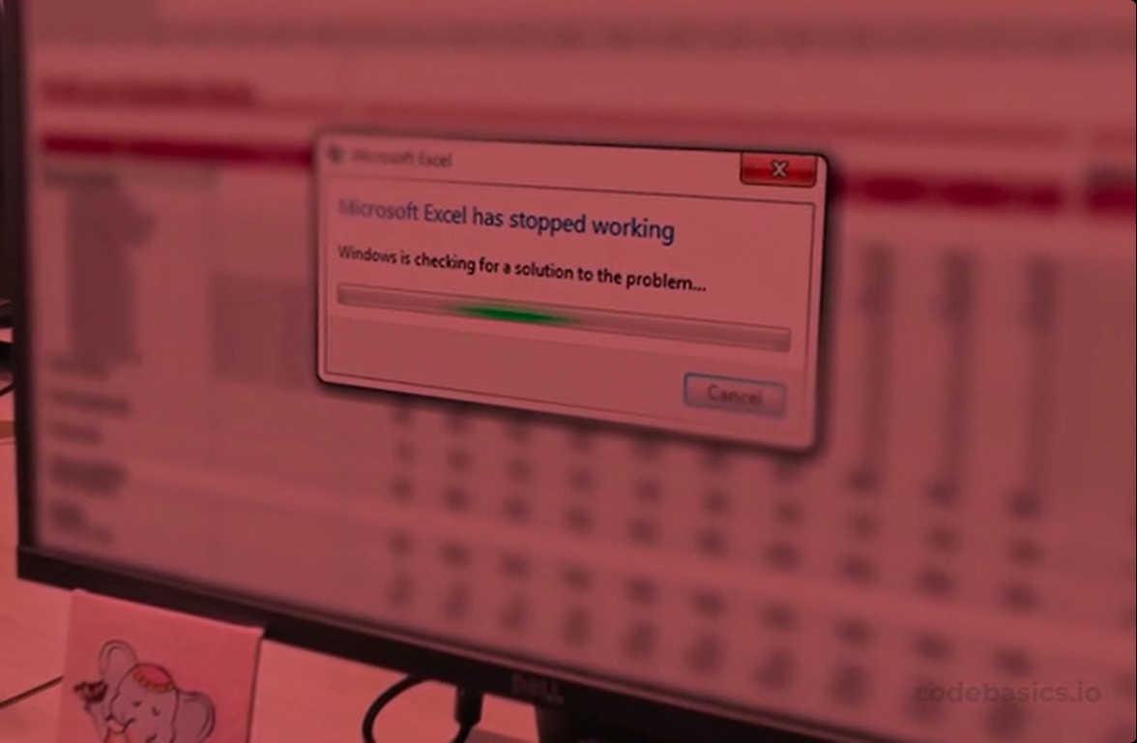
2.Problem Statement
The enlarging size of Excel files has led to lower Excel performance, resulting in non-functional and fragile. To address this concern, AtliQ Hardware has hired data professionals who will use MySQL as their database to analyze and extract insights from the data for the company's development.

Slide 7

3.Project Objectives
Solving queries related to sales, finance, market & regional analysis, customer behavior and supply chain forecasting.

Slide 8
4.Tools & Database
i) Tools used for this project
MySQL
Excel

Slide 9
4.Tools & Database
dim_customer
dim_product
ii) Database of this project
dim_forecast_monthly
gdb0041
Tables
fact_freight_cost
fact_gross_price
fact_manufacturing_cost
fact_post_invoice_deductions
fact_pre_invoice_deductions
fact_sales_monthly

Slide 10
5. Reports

Slide 11
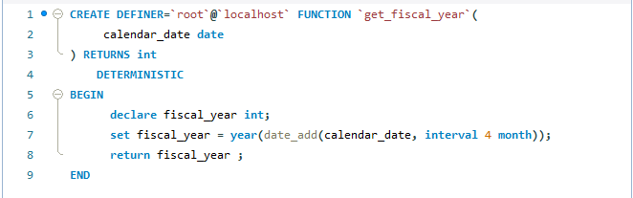
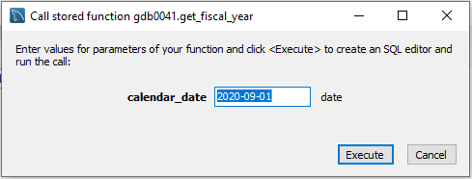
i). Generate a report of individual product sales for croma India customer of FY-2021.
Steps to be followed to generate report:
User defined function: created user defined function ‘get_fiscal_year’ for fiscal year to get report of any fiscal year.

Slide 12
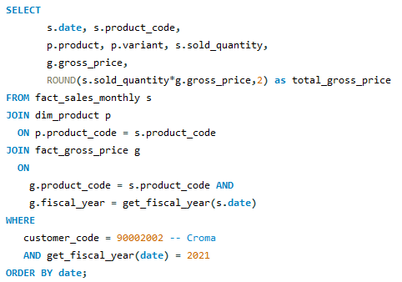
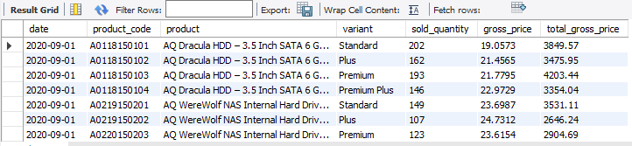
i). Generate a report of individual product sales for croma India customer of FY-2021.
SQL Query
Output

Slide 13
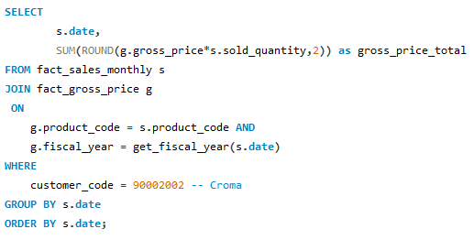
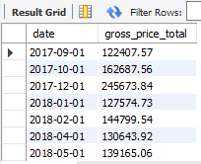
ii). Generate an aggregate monthly gross sales report for Croma India customers.
SQL Query
Output

Slide 14
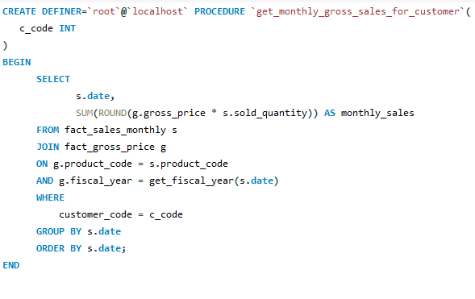
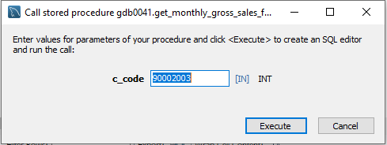
ii). Generate an aggregate monthly gross sales report for Croma India customers.
Additional work(1)
Created stored procedure ‘get_monthly_gross_sales_for_customer’
to generate monthly gross sales report for any customer.

Slide 15
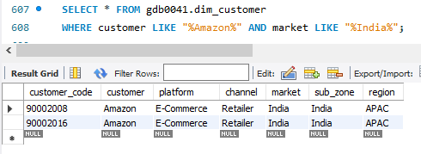
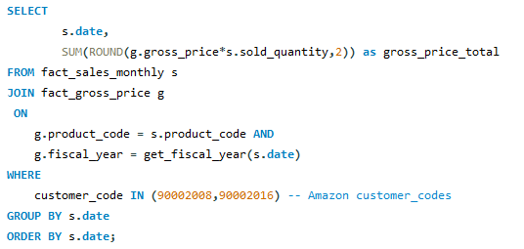
ii). Generate an aggregate monthly gross sales report for Croma India customers.
Additional work(2)
Customer with two customer_code.
Example: Amazon customer has two
customer_code
SQL query before creating stored
Procedure.

Slide 16
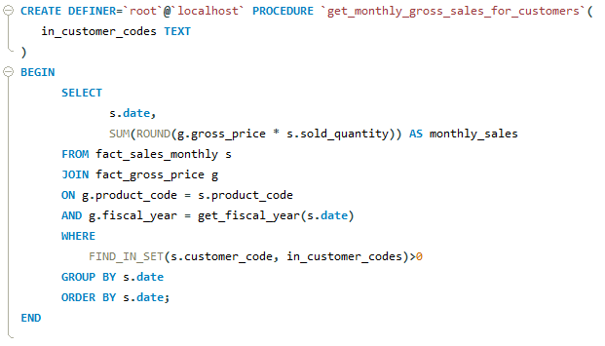
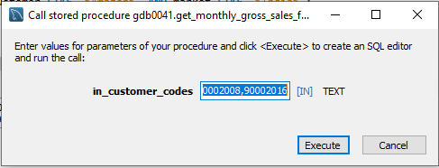
ii). Generate an aggregate monthly gross sales report for Croma India customers
Created stored procedure ‘get_monthly_gross_sales_for_customers’
to generate monthly gross sales report for customer with two
customer_code.

Slide 17
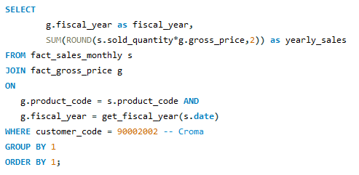
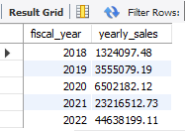
iii). Generate a yearly gross sales report for Croma India customers.
SQL Query
Output

Slide 18
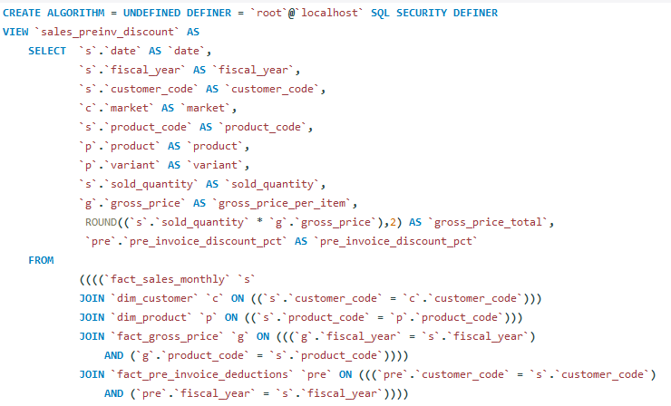
iv). Generate a report of top market net sales for a given financial year.
Steps to be followed to generate report:
Created views ‘sales_preinv_discount’ & ‘sales_postinv_discount’ for future use.
sales_preinv_discount

Slide 19
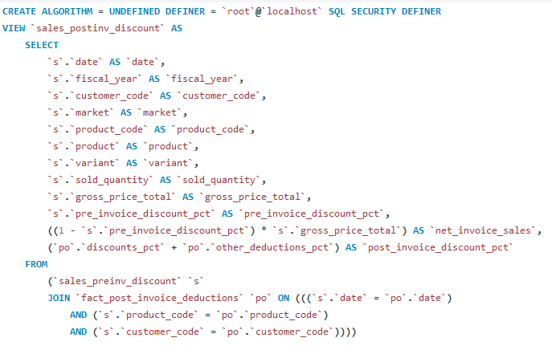
iv). Generate a report of top market net sales for a given financial year.
sales_postinv_discount

Slide 20
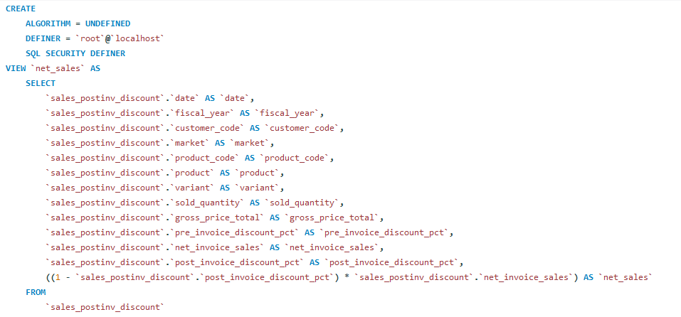
iv). Generate a report of top market net sales for a given financial year.
Created one more view ‘net_sales’ by using view ‘sales_postinv_discount’

Slide 21
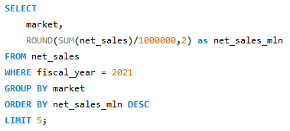
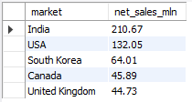
iv). Generate a report of top market net sales for a given financial year.
Created report for top 5 market for fiscal year – 2021 by using net_sales view.
SQL Query
Output

Slide 22
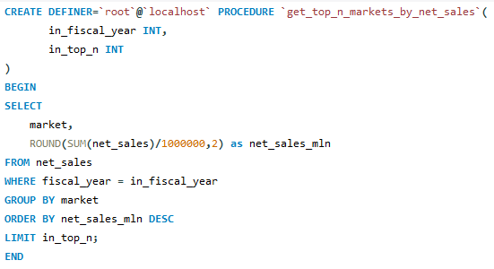
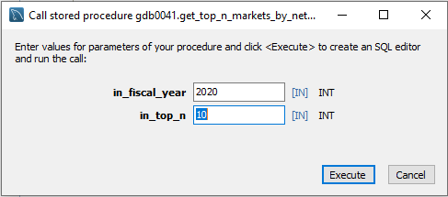
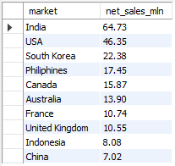
iv). Generate a report of top market net sales for a given financial year.
Then by using previous SQL query created stored procedure
`get_top_n_markets_by_net_sales` for top-n market of any given fiscal year.
Calling stored procedure
Output

Slide 23
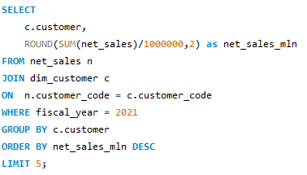
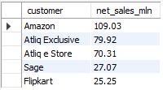
v). Generate a report of top customer net sales for a given financial year.
Created report for top 5 customer for fiscal year – 2021.
SQL Query
Output

Slide 24
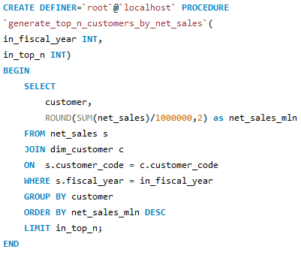
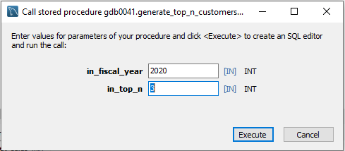

v). Generate a report of top customer net sales for a given financial year.
Created stored procedure `generate_top_n_customers_by_net_sales` to extract
top-n customer for any given fiscal year.
Calling stored procedure
Output

Slide 25
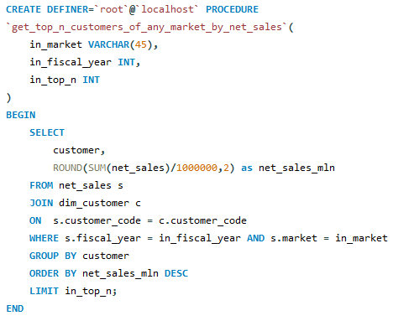
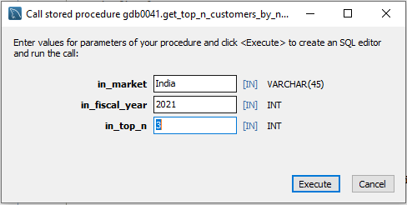

v). Generate a report of top customer net sales for a given financial year.
Additional work
Created procedure `get_top_n_customers_of_any_market_by_net_sales`
for top-n customer of any market & any given fiscal year.
Calling stored procedure
Output

Slide 26
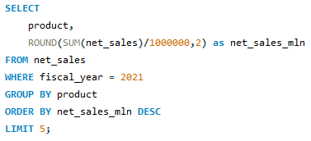
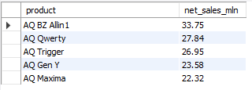
vi). Generate a report of top product net sales for a given financial year.
Created report for top 5 product for fiscal year – 2021.
SQL Query
Output

Slide 27
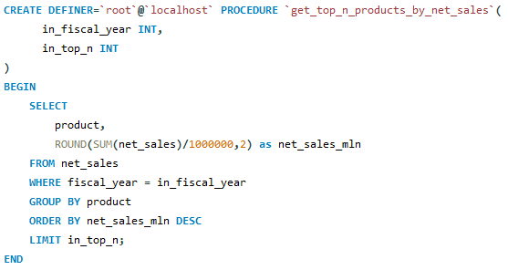
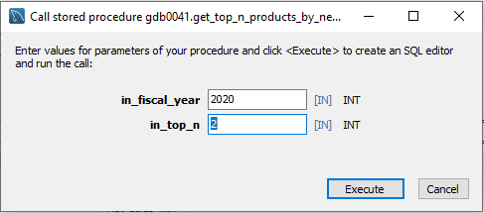

vi). Generate a report of top product net sales for a given financial year.
Created stored procedure `get_top_n_products_by_net_sales`
for top-n products of any given fiscal year.
Calling stored procedure
Output

Slide 28
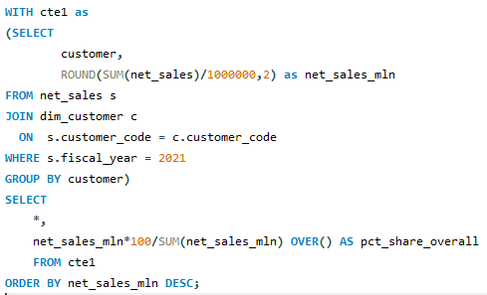
vii). Generate a bar chart report for financial year-2021 for top 10 customers by % net sales .
SQL Query
Output

Slide 29
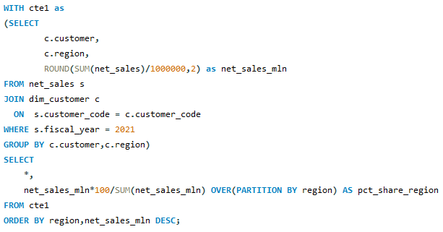
viii). Generate a report for financial year-2021 for top 10 customers by region wise % net sales .
SQL Query

Slide 30
viii). Generate a report for financial year-2021 for top 10 customers by region wise % net sales .
Output

Slide 31
viii). Generate a report for financial year-2021 for top 10 customers by region wise % net sales .
Output

Slide 32
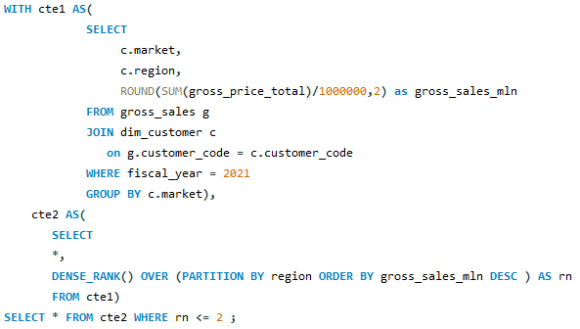
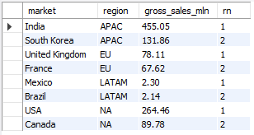
ix). Generate a report for top 2 markets in every region by their gross sales amount for fiscal year – 2021.
SQL Query
Output

Slide 33
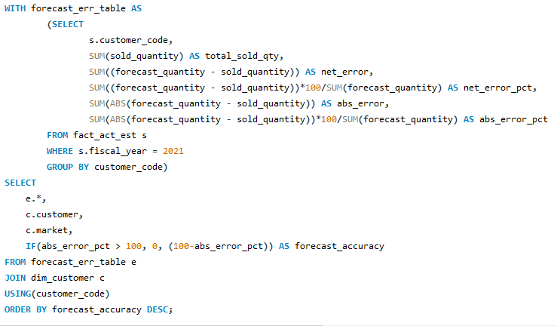
x). Generate forecast accuracy report for all the customers for a given fiscal year.
Created report for fiscal year - 2021
SQL Query

Slide 34
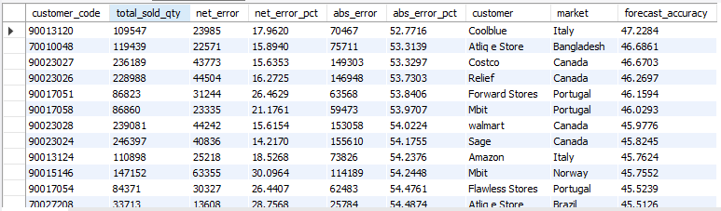
x). Generate forecast accuracy report for all the customers for a given fiscal year.
Output

Slide 35
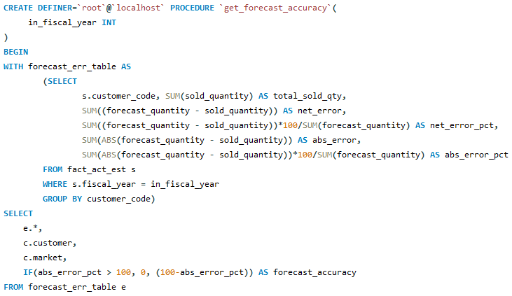
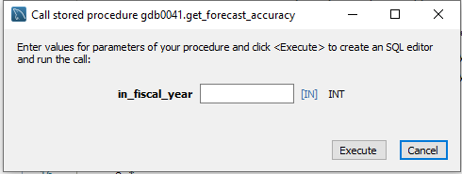

x). Generate forecast accuracy report for all the customers for a given fiscal year.
Created stored procedure ‘get_forecast_accuracy’ for forecast accuracy report of
any given fiscal year.
SQL Query

Slide 36
6.Key Insights
AtliQ Hardware achieved the highest sales in FY-2022.
India was the top market with the highest net sales in FY-2021.
Amazon contributed 13.23% to the global market share in FY-2021.
The net sales percentage of Amazon was highest in three out of four regions in FY-2021.

Slide 37
Thank You!

